Slide 1

Application: NutraMeals Type: Application Architecture
View: Logical View Style: Layered Architecture Pattern
Users
Deliver Channels
Core Business Processes
Data And Information
Technology Enablers
Web App
Account Management
User Account Details
Email/Phone Number
Customers
Search
Search Food/Restaurant
Restaurant search API
Internet
Advertisement
Restaurant Promotions
Real Time Event Bus
Admin
Order Placement
Placing an order
Order API
Web APP
Payment Management
Payment Information
B2B-gateway
Restaurants

Slide 2
Application: NutraMeals Type: Application Architecture
View: Process View Style: Client-Server Architecture Pattern

Slide 3
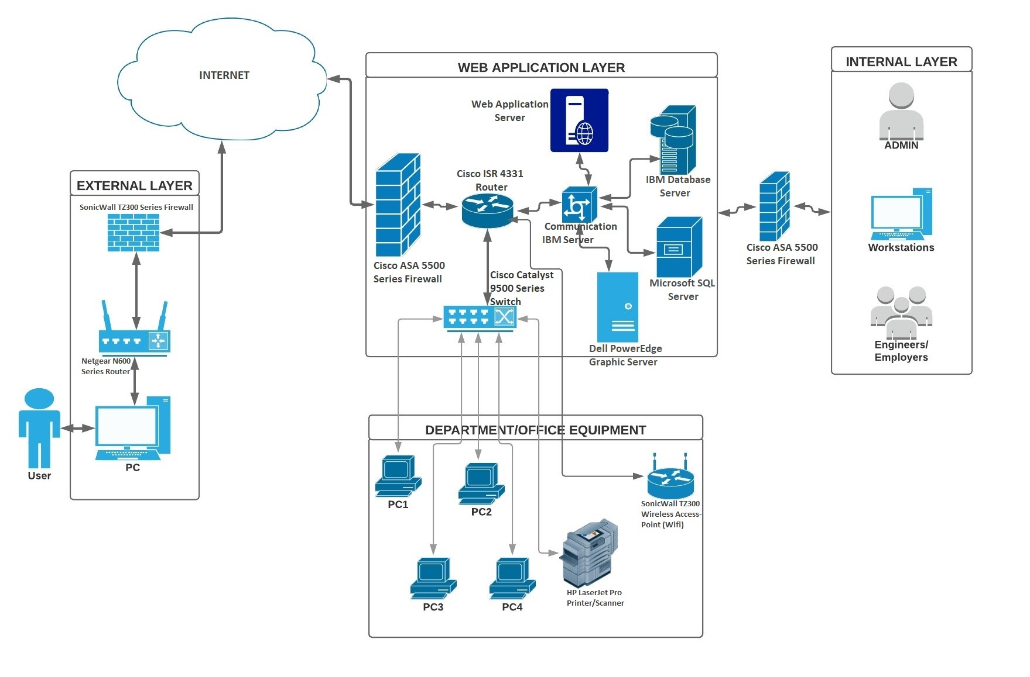
Application: NutraMeals Type: Application Architecture
View: Physical View Style: Client-Server Architecture Pattern

